Slide 1
ABSTRACT NOUN

Slide 2
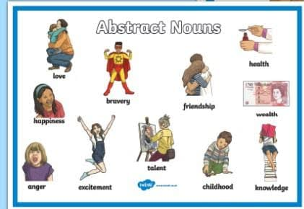
Abstract Noun
Nouns that are names of qualities, status, feelings and actions are abstract nouns.

Slide 3
Qualities
Goodness
Wisdom
Beauty
Truth
Obedience

Slide 4
States
Happiness
Friendship
Youth
Comfort
Freedom

Slide 5
Feelings
Hatred
Sympathy
Sadness
Love
Pride

Slide 6
Actions
Anger
Advice
Permission
Movement
Thought

Slide 7
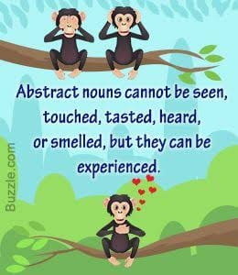

Slide 8
Abstract nouns formed from adjectives
ADJECTIVE
ABSTRACT NOUN
brave
honest
poor
high
deep
long
proud
true
short
bravery
honesty
poverty
height
depth
length
pride
truth
shortage

Slide 9
ADJECTIVE
ABSTRACT NOUN
strong
Clean
courage
just
wise
beautiful
intelligent
strength
cleanliness
courageous
justice
wisdom
beauty
intelligence

Slide 10
THANK YOU

